Slide 1
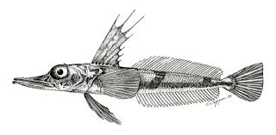
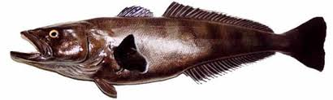
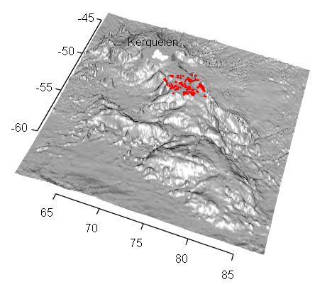
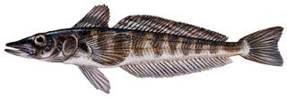

Modelling the distribution of sub- Antarctic demersal fish communities: An application of new community –modelling method
Nicole Hill, Scott Foster, Guy Duhammel,
Philippe Koubbi, Dirk Welsford, Craig Johnson

Slide 2
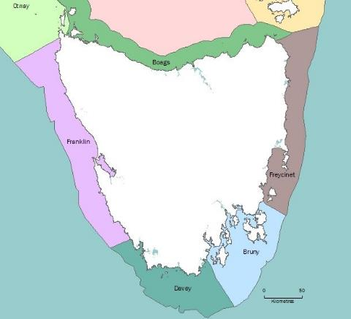
Background- community modelling
Understanding the spatial distribution of
species and their relationship with
environmental factors forms a central
tenant in ecology
Numerous conservation applications
Delineating spatial units
Prioritising effort
Developing baselines
Predicting change
Increasing focus on biodiversity and multispecies assemblages rather than individual species
Often want to identify regions in space that contain similar assemblage
Notes:
Understanding the spatial distribution of species and their relationship with environmental factors forms a central tenant in ecology. Understanding such biogeographic patterns is not just of esoteric interest, but has many applications, notably in conservation management. These range from delineating spatial management units, prioritising conservation efforts, developing baselines for monitoring and predicting future change. Increasingly conservation efforts are interested in questions surrounding biodiversity and moving from quantifying spatial patterns of single species and diversity metrics, like species richness, to quantifying patterns in multi-species assemblages directly. In response there have been a plethora of statistical techniques developed in recent years to address this need

Slide 3
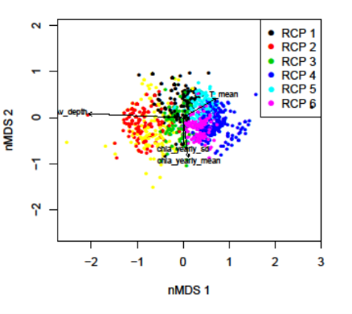
Background- community modelling
Ecologists often use distance matrix to summarise multispecies data and then perform ordination, clustering etc
Diagnostics, Interpretation, prediction not straightforward
Notes:
Understanding the spatial distribution of species and their relationship with environmental factors forms a central tenant in ecology. Understanding such biogeographic patterns is not just of esoteric interest, but has many applications, notably in conservation management. These range from delineating spatial management units, prioritising conservation efforts, developing baselines for monitoring and predicting future change. Increasingly conservation efforts are interested in questions surrounding biodiversity and moving from quantifying spatial patterns of single species and diversity metrics, like species richness, to quantifying patterns in multi-species assemblages directly. In response there have been a plethora of statistical techniques developed in recent years to address this need

Slide 4
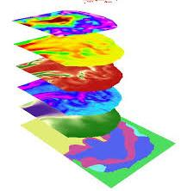
Background- community modelling
Ecologists often use distance matrix to summarise multispecies data and then perform ordination, clustering etc
Diagnostics, Interpretation, prediction not straightforward
Model-based alternatives:
Model and predict single species & group
Group first then predict
Do both at once
Notes:
Understanding the spatial distribution of species and their relationship with environmental factors forms a central tenant in ecology. Understanding such biogeographic patterns is not just of esoteric interest, but has many applications, notably in conservation management. These range from delineating spatial management units, prioritising conservation efforts, developing baselines for monitoring and predicting future change. Increasingly conservation efforts are interested in questions surrounding biodiversity and moving from quantifying spatial patterns of single species and diversity metrics, like species richness, to quantifying patterns in multi-species assemblages directly. In response there have been a plethora of statistical techniques developed in recent years to address this need

Slide 5
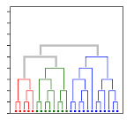
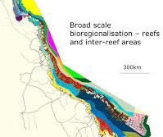
Background- community modelling
Ecologists often use distance matrix to summarise multispecies data and then perform ordination, clustering etc
Diagnostics, Interpretation, prediction not straightforward
Model-based alternatives:
Model and predict single species & group
Group first then predict
Do both at once
Notes:
Understanding the spatial distribution of species and their relationship with environmental factors forms a central tenant in ecology. Understanding such biogeographic patterns is not just of esoteric interest, but has many applications, notably in conservation management. These range from delineating spatial management units, prioritising conservation efforts, developing baselines for monitoring and predicting future change. Increasingly conservation efforts are interested in questions surrounding biodiversity and moving from quantifying spatial patterns of single species and diversity metrics, like species richness, to quantifying patterns in multi-species assemblages directly. In response there have been a plethora of statistical techniques developed in recent years to address this need

Slide 6
Regions of Common Profile
An RCP is a region of environmental space within which the vector of species’ probabilities of being sampled is (relatively) constant and distinct from other regions

Slide 7
Regions of Common Profile
An RCP is a region of environmental space within which the vector of species’ probabilities of being sampled is (relatively) constant and distinct from other regions
Species A
Species B
Prob of Occurrence
Depth
RCP 1
RCP 2
RCP 3

Slide 8
Regions of Common Profile
An RCP is a region of environmental space within which the vector of species’ probabilities of being sampled is (relatively) constant and distinct from other regions
Across many species and environmental variables
Species A
Species B
Prob of Occurrence
Depth
RCP 1
RCP 2
RCP 3
RCP | Species A | Species B
RCP 1 | 0.10 | 0.75
RCP 2 | 0.40 | 0.90
RCP 3 | 0.70 | 0.72
= profile for RCP 1
= profile for RCP 2
= profile for RCP 3

Slide 9
Regions of Common Profile
An RCP is a region of environmental space within which the vector of species’ probabilities of being sampled is (relatively) constant and distinct from other regions
Across many species and environmental variables
Species A
Species B
Prob of Occurrence
Depth
RCP 1
RCP 2
RCP 3
RCP | Species A | Species B
RCP 1 | 0.10 | 0.75
RCP 2 | 0.40 | 0.90
RCP 3 | 0.70 | 0.72
= profile for RCP 1
= profile for RCP 2
= profile for RCP 3
But we don’t know the number of groups or their boundaries to begin with so we have to let the data inform this process (latent variable)

Slide 10
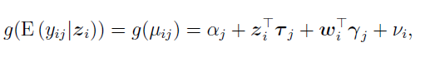
Regions of Common Profile
Notes:
Mixture of experts model: RCP model for the jth species at the ith site:
Z= latent categorical variable for each site
T= species parameters describing step change for each RCP
W=vector of sampling covariates at a site
Y= species specific response to sampling covariates
Vi = an offset for site i
Tau= multinomial sampling process with one trial, and kx1 probability vector
Prob vector can vary as a function of environmental covariates at a site- additive logistic link function.
Estimation is by penalised maximum likelihood

Slide 11
Regions of Common Profile
Expected count/ biomass/ occurrence of a particular species at a particular site given that site belongs to a particular RCP
Notes:
Mixture of experts model: RCP model for the jth species at the ith site:
Z= latent categorical variable for each site
T= species parameters describing step change for each RCP
W=vector of sampling covariates at a site
Y= species specific response to sampling covariates
Vi = an offset for site i
Tau= multinomial sampling process with one trial, and kx1 probability vector
Prob vector can vary as a function of environmental covariates at a site- additive logistic link function.
Estimation is by penalised maximum likelihood

Slide 12
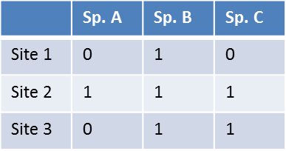
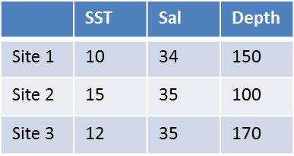
Regions of Common Profile
Expected count/ biomass/ occurrence of a particular species at a particular site given that site belongs to a particular RCP
Describes how each species is related to each RCP via environmental variable
Site x Species matrix
Environmental matrix
Notes:
Mixture of experts model: RCP model for the jth species at the ith site:
Z= latent categorical variable for each site
T= species parameters describing step change for each RCP
W=vector of sampling covariates at a site
Y= species specific response to sampling covariates
Vi = an offset for site i
Tau= multinomial sampling process with one trial, and kx1 probability vector
Prob vector can vary as a function of environmental covariates at a site- additive logistic link function.
Estimation is by penalised maximum likelihood

Slide 13
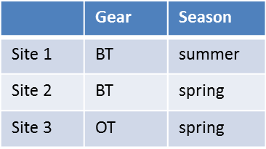
Regions of Common Profile
Expected count/ biomass/ occurrence of a particular species at a particular site given that site belongs to a particular RCP
Describes how each species is related to each RCP via environmental variable
Factors that affect catchability of species.
Sampling effects matrix
Site x Species matrix
Environmental matrix
Notes:
Mixture of experts model: RCP model for the jth species at the ith site:
Z= latent categorical variable for each site
T= species parameters describing step change for each RCP
W=vector of sampling covariates at a site
Y= species specific response to sampling covariates
Vi = an offset for site i
Tau= multinomial sampling process with one trial, and kx1 probability vector
Prob vector can vary as a function of environmental covariates at a site- additive logistic link function.
Estimation is by penalised maximum likelihood

Slide 14
Regions of Common Profile
An offset
Expected count/ biomass/ occurrence of a particular species at a particular site given that site belongs to a particular RCP
Describes how each species is related to each RCP via environmental variable
Factors that affect catchability of species.
Sampling effects matrix
Site x Species matrix
Environmental matrix
Notes:
Mixture of experts model: RCP model for the jth species at the ith site:
Z= latent categorical variable for each site
T= species parameters describing step change for each RCP
W=vector of sampling covariates at a site
Y= species specific response to sampling covariates
Vi = an offset for site i
Tau= multinomial sampling process with one trial, and kx1 probability vector
Prob vector can vary as a function of environmental covariates at a site- additive logistic link function.
Estimation is by penalised maximum likelihood

Slide 15
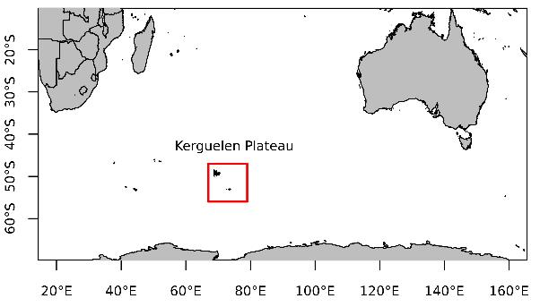
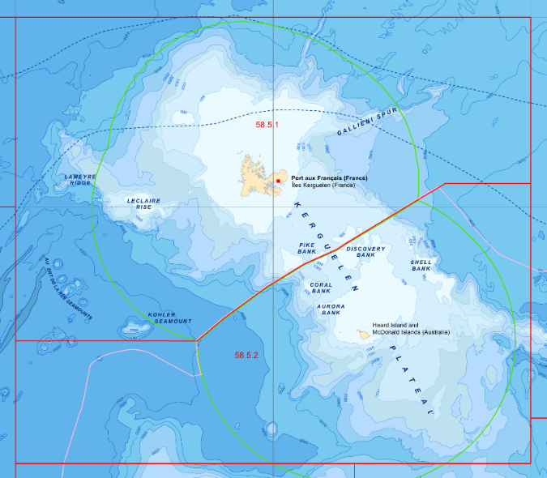
An Application: Sub-Antarctic demersal fish
Physical Setting:
Largest submarine plateau
Geology shaped by volcanism and glaciers
Confluence of oceanographic fronts
Complex oceanography
Nutrient rich waters

Slide 16
An Application: Sub-Antarctic demersal fish
Physical Setting:
Largest submarine plateau
Geology shaped by volcanism and glaciers
Confluence of oceanographic fronts
Complex oceanography
Nutrient rich waters
Biological Setting:
Highly productive
Foraging areas for birds, mammals
Diverse seabed invertebrates
Significant fishery for Toothfish and Icefish

Slide 17
An Application: Sub-Antarctic demersal fish
Management Setting:
Australian Territory and French Territory
Fisheries managed by CCAMLR
HIMI World Heritage Listed 1997
HIMI Marine Reserve declared 2002

Slide 18
An Application: Sub-Antarctic demersal fish
Existing knowledge on distribution of key fisheries species, but not demersal fish assemblages as a whole
Aims:
Quantitatively characterise demersal fish assemblages on Kerguelen Plateau
Delineate spatial distribution of assemblages
Understand relationships with and relative importance of environmental variables

Slide 19
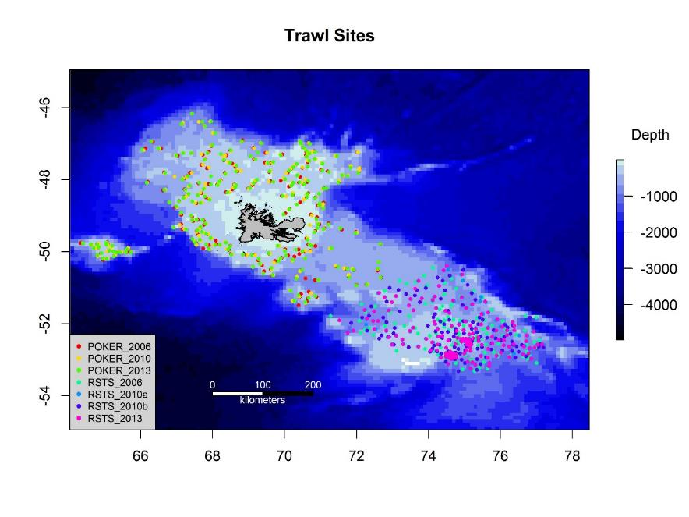
Sub-Antarctic demersal fish: The Data
Demersal fish trawls from French and Australian scientific surveys
7 surveys throughout 2006, 2010, 2013
Similar gear: Otter trawls, differing mesh
30 min trawls
1000 m max depth
Presence/absence 23 species per trawl
Dataset | 2006 | 2010 | 2013
POKER | 189 | 205 | 198
RSTS | 153 | 312 | 138

Slide 20
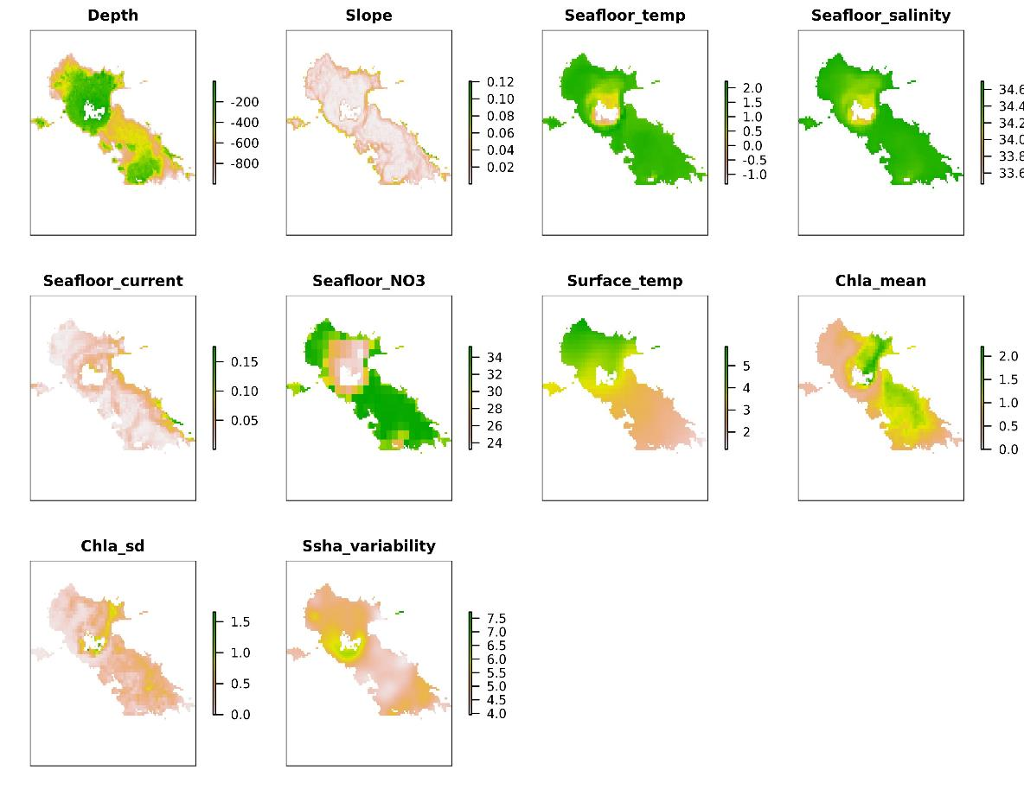
Sub-Antarctic demersal fish: The Data
Covariates correlated <0.7
Initial screening using GAMs for each species and covariate

Slide 21
Sub-Antarctic demersal fish: Modelling approach
No covariate selection then choose number clusters (RCPs) using BIC

Slide 22
Sub-Antarctic demersal fish: Modelling approach
No covariate selection then choose number clusters (RCPs) using BIC
Covariate selection:
Start with all covariates and their quadratics
Backwards selection
Choose ‘best model’ for given RCP
Check nRCPs
Survey included as a sampling factor
Full model
Step 1
Notes:
Need to remind that multiple random starts necessary to avoid inference on local maxima

Slide 23
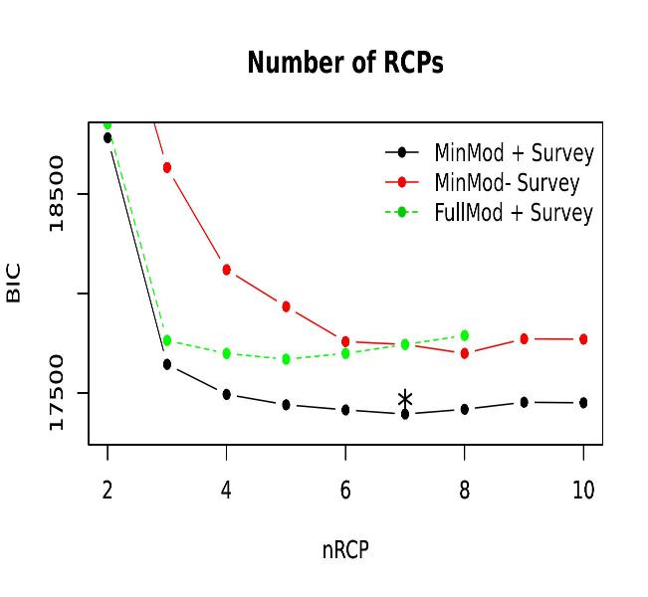
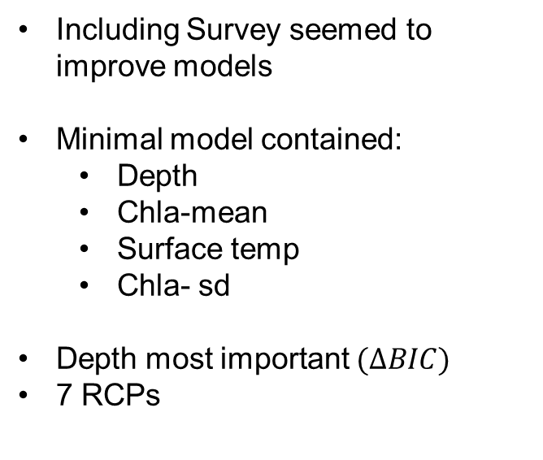
Sub-Antarctic demersal fish: Results
Including Survey seemed to improve models
Minimal model contained:
Depth
Chla-mean
Surface temp
Chla- sd
Depth most important $(∆BIC)$
7 RCPs

Slide 24
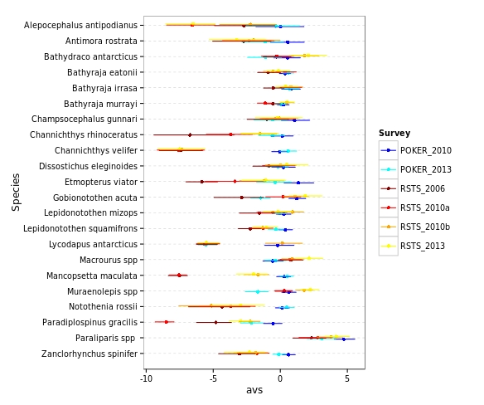
Sub-Antarctic demersal fish: Results
Sampling Effects

Slide 25
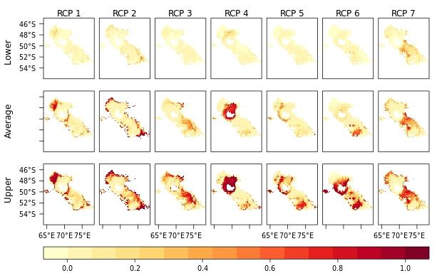
Sub-Antarctic demersal fish: Results

Slide 26
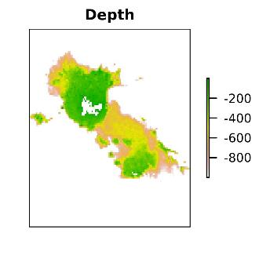
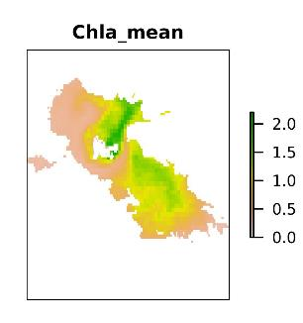
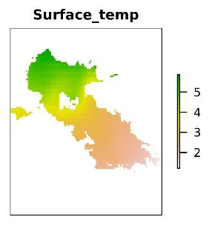
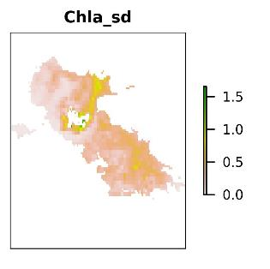
Sub-Antarctic demersal fish: Results
Hard Clustering
Species | RCP2 | RCP7 | RCP3 | RCP1 | RCP5 | RCP4 | RCP6
D. eleginoides | 0.98 | 0.95 | 0.98 | 0.98 | 1 | 0.84 | 0.98
Paraliparis spp | 0 | 0.01 | 0 | 0 | 0 | 0 | 0
A. antipodianus | 0.53 | 0.02 | 0 | 0.01 | 0 | 0 | 0
A. rostrata | 0.88 | 0.11 | 0.14 | 0.02 | 0.01 | 0 | 0
Muraenolepis spp | 0.08 | 0.46 | 0.41 | 0.14 | 0.18 | 0.06 | 0.29
M. maculata | 0.04 | 0.1 | 0.74 | 0.4 | 0.65 | 0.14 | 0.52
C. gunnari | 0.01 | 0.01 | 0.18 | 0.02 | 0.59 | 0.99 | 0.95
L. squamifrons | 0.18 | 0.27 | 0.84 | 0.96 | 0.92 | 0.43 | 0.82
Z. spinifer | 0 | 0.04 | 0.06 | 0.28 | 0.58 | 0.41 | 0.7

Slide 27

Sub-Antarctic demersal fish: Results
Hard Clustering
Comparison with traditional clustering
(survey sites)

Slide 28
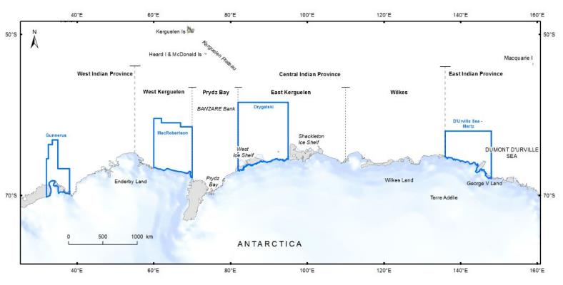
Sub-Antarctic demersal fish: Next steps
Refine models
Validation. Predictive LL?
Provide quantitative baseline of distribution of fish assemblages within the reserve
Improve understanding of biodiversity values in region
Extend to East Antarctica

Slide 29
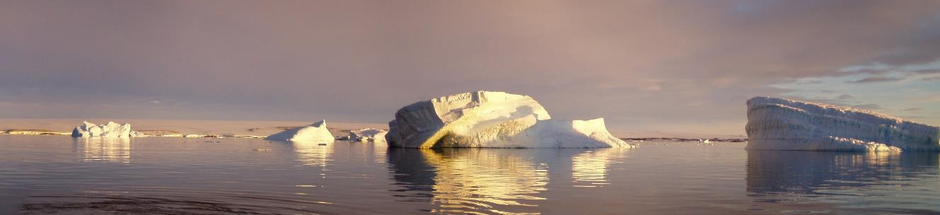
Acknowledgements
Rebecca Leaper
Patrice Pruvost (MNHN)
Romain Causse (MNHN)
Tim Lamb (AAD)
Stuart Corney (ACE CRC)
Mike Sumner (ACE CRC)
Australian and French Scientific Observers

